Slide 1

TESCO
BUSINESS INTELLIGENCE

Slide 2
List of contents
TESCO
Overview of case and Organisation
Problem Identification
Clear Ideas Framework
VISA Appraisal
Recommendation
Conclusion

Slide 3
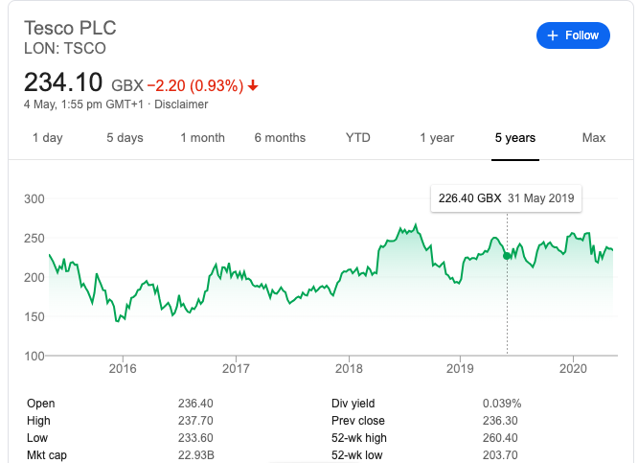
Overview of case and Organisation
Tesco plc, trading as Tesco, is a British multinational groceries and general merchandise retailer with headquarters in Hertfordshire, England, United Kingdom.
It is the third-largest retailer in the world measured by gross revenues and the ninth-largest retailer in the world measured by revenues.
It has shops across Asia and Europe and has more than 6500 + shops

Slide 4
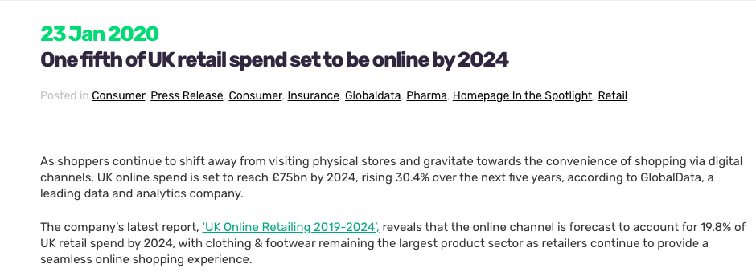
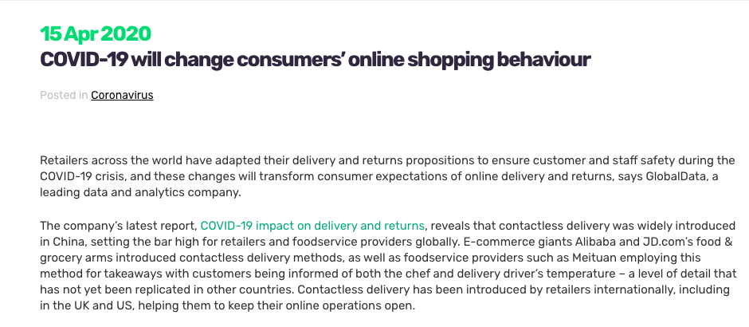
Overview of case and Organisation
As COVID-19 pandemic breakout , we can expect an uncommon dip in there income this year as a large portion of the income produces in the period of time where it is the phenomenal month for basic food item retailers.
Before that there were sufficient stock ,and well sustained supply chain system, in the stores no lines and simple path for the window shopping.
Pandemic Situation forcing Shoppers to make purchasing online , and increasing the frequency and volume of online shopping by several folds

Slide 5

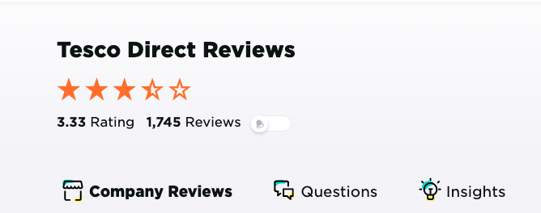
Overview of case
According to our Findings ,TESCO online shoppings getting reviews as worst, bad experience a for the online requests, similar to the conveyance has been deferred or outdated items have been conveyed rather than great one.
To add more to the hassle, failed payment, customer woes include broken customer review system ,etc
Bad User Experience in some cases, not mobile first user experience

Slide 6
Problem Identification
The website needs to improve mainly on following areas
User Experience
Reliability
Communication Feedback Loop

Slide 7
Clear Ideas-Cause of problems
The User Experience of using the website, has certain issues regarding usability like no clearly defined layouts for mobile experience and accessibility
Issues in Delivery Supply chain system ,no proper tracking of delivery dates
Failed Payment systems and rollback of transactions, takes too much
No proper and active feedback system for customers to proactively report the issues.

Slide 8
Clear Ideas-to solve problems
Including ChatOps in the messaging apps and in website
Gamification of entire shopping experience
Adding More Payment Gateways and Merchants
Active Tracking of Delivery and early indication of delivery delay

Slide 9
Attribute Tree
Attributes
Overall Objective
Sub-Objectives
A/B Testing
CRMS
Communication channels
Sub-Objectives: Functionality, Reliability & Interoperability
Distilled from major goals outlined through secondary research
Found that most attributes fit under all three objectives
Attributes
Attained from research into current website and ways to improve it
Functionality
Accesibility
Customer Exp(CX)
User
Journey Maps
Improved UX
Gamification
Payment Gateway Rollback
TESCO
Reliability
Fraud Detection
Data security
Cost Optimisation
3rd Party App Tracking
Interoperability
Efficient Supply Chain Tracking
Chat bot Support
Multiple Gateway Support

Slide 10
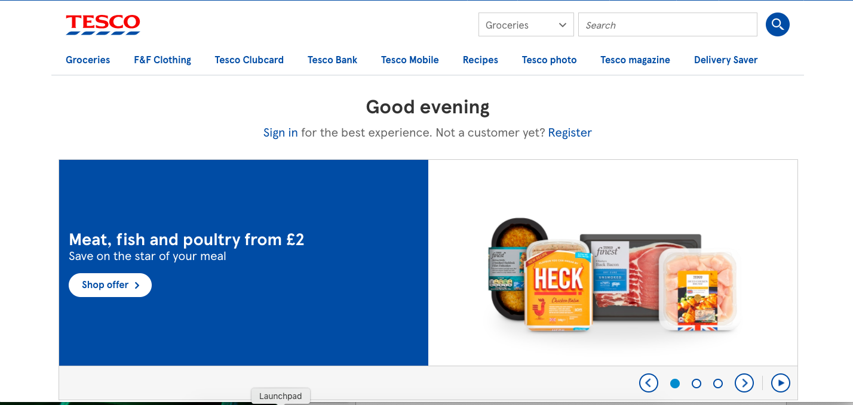
Website
Poor Customer Experience (Customisation)
NO GUEST ACCOUNT SUPPORT
NO AI/Data driven advts

Slide 11
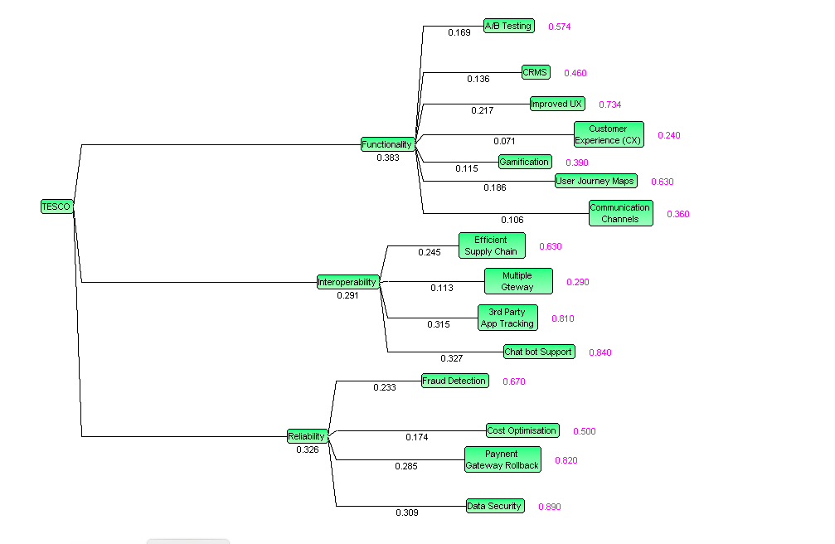
VISA DIAGRAM

Slide 12
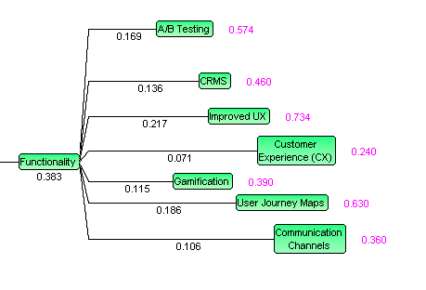
VISA DIAGRAMS
Including ChatOps in the messaging apps and in website
Gamification of entire shopping experience
Adding More Payment Gateways and Merchants
Using CRM Software

Slide 13
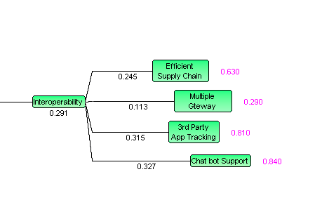
VISA DIAGRAM
Adding More Payment Gateways and Merchants
Utilising efficient supply chain systems
Integration of 3rd Party App

Slide 14
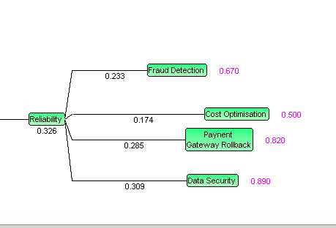
VISA DIAGRAM
Text
Implementing Fraud Detection Systems
Cost Optimisation using modern tech resources
Data Security measures according to latest compliance and regulatory measures
Payment Refund / Rollback System integration

Slide 15
RECOMMDATION
Through the VISA and prior research we recommend the TESCO should adapt to mobile first approach for building websites
Improved Support through Chatbots (Chat Operations)
Active Tracking system for Early Delays in Delivery based on supply chains
Gamification and Customisation based on the User Group

Slide 16
CONCLUSION
The UK Retail in Online Shopping is set to drastically increase , TESCO has massive advantage with supply chain ( Brick & Mortar Stores)
Improved Chat and feedback from customers from iterations , improving Customer Experience
This investigation stays sensible as through our entrance to the framework we have gotten more prominent experience utilising most specialised viewpoints; along these lines narrowing the SCOPE of our Case Study and giving appropriate suggestions.

Slide 17
REFERENCeS
https://www.tesco.com/
https://www.reviews.io/company-reviews/store/tesco-direct
https://uk.trustpilot.com/review/www.tesco.com
https://www.thehindubusinessline.com/opinion/covid-19-impact-consumers-move-more-towards-digital/article31337127.ece
https://www.globaldata.com/covid-19-will-change-consumers-online-shopping-behaviour/
https://www.globaldata.com/one-fifth-of-uk-retail-spend-set-to-be-online-by-2024/
https://medium.com/walmartlabs
https://medium.com/bestfolios/6-google-ux-case-studies-from-google-designers-14509b47ad0c
https://blog.smile.io/3-gamification-strategies-to-use-for-your-ecommerce-store/

